Slide 1
NORTH CAROLINA NATIONAL GUARD
M-DAY RETIREMENT SERVICES
UNCLASSIFIED

Slide 2
Retirement Services Office
The Retirement Services Office (RSO) mission to serve goes beyond the traditional drilling Soldier and extends to Retirees, Families, Survivors, and the Active Duty Staff. Services that the RSO provide:
Reserve Component Survivor Benefit Plan Counseling (coverage/cost)
Retirement Options
Pay Computation
Early Retirement
State Pension Plan
Retirement Pay Application Process (including Medical)
Retiree Benefits
Retirement Resources
Retirement Points Updates

Slide 3
Agenda
Retirement Point Updates (RPAM)
Early Retirement Eligibility (RPED)
20-year letters
Reserve Component Survivor Benefit Plan (RC-SBP) Counseling
Retirement Options
Retirement Benefits
State Pension
Blended Retirement System

Slide 4
Retirement Points Accounting Management (RPAM)
Understand the responsibilities of Soldier Support Personnel for RPAM at various levels
Ensure that each Soldier is able to understand and verify their RPAM statement yearly
Ensure all Soldiers understand the 20-year letter process

Slide 5
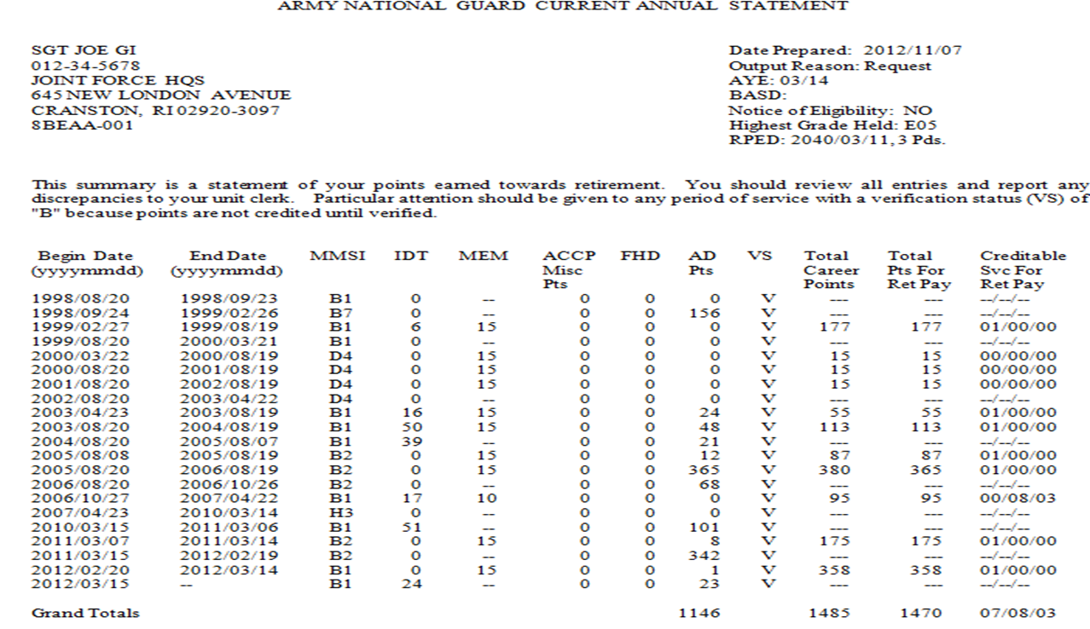
Reading the Retirement Points Annual Statement (RPAS)

Slide 6
Correcting the RPAS
Supporting documents include but are not limited to:
LES’s
1379’s
DD 214’s
MMPA’s
1059’s
Documents that cannot be used to verify include but are not limited to:
Tax Forms
W-2’s
Bank Statements
Travel Vouchers
Orders

Slide 7
Retirement Pay Eligibility Date (RPED)
Per PPOM 13-029, AD tours on or after 29 JAN 2008 can be credited in aggregate periods of 90 days within an FY to allocate RPED periods. 01 Oct 2014 – Present early retirement periods can cross fiscal years. These periods reduce the date at which a Service Member can receive their retired pay by 3 months per period.
Creditable service for these periods include, but are not limited to:
Title 10 USC 12301(a), 12301(d), 12302, 12304, 12305, 12406
Title 32 USC 502(f) ONLY for the purposes of responding to a national emergency as declared by the President/ supported by Federal Funds

Slide 8
Responsibility of the Soldier
Review NGB Form 23 A annually for accuracy
Provide source documents for any updates needed
Review 20-year letter and provide SBP election within the 90 day suspense

Slide 9
Responsibilities of the Unit
Review NGB Form 23 A with Soldier
Send reviewed NGB Form 23 A to Retirement Services section with supporting documentation to update record, if needed
Ensure that an updated NGB 23 A is in the Soldier’s iPERMS record after each Annual Records Review
Assist in processing Retirement Packets
Advise/Counsel Members on Reserve Component Survivor Benefit Plan (RC-SBP) election options upon receipt of 20-year letter
Submit all 1379’s to the RSO for Soldiers drilling for points only in order to update points manually

Slide 10
Responsibilities of the RSO
Provide Soldier with an accurate account of retirement data
Monitor verification of retirement points
Maintain an automated history
Issue Notification of Eligibility for Retired Pay at Age 60 (20-year letter)
Forward RPAM records as requested

Slide 11
20-year letters
20-year letters are issued once each month. (States determine how often and when letters will be issued.) North Carolina issues letters around the 15th of every month.
20-year letters are uploaded into iPERMS within 2 days of being issued. DD Form 2656-5 (RC-SBP Election) will be included with letter.
It is the Soldiers responsibility to ensure RC-SBP election is made within 90 days.

Slide 12
Reserve Component Survivor Benefit Plan (RC-SBP)
RC-SBP gives retirement eligible Soldiers the option to leave up to 55% of their retired pay to surviving dependents. Your election here has an effect on SBP at 60.
Soldier has 90 days from the 20-year letter date to complete the RC-SBP Packet.
Defaults to the highest coverage amount if no election is made. (Option C)

Slide 13
Retirement Options
Remain in the Guard
Individual Ready Reserve (IRR)
Retired Reserve
Discharge
Each of these choices have an effect on retirement pay benefits.

Slide 14
Retirement Options Cont.
Remain in the Guard
Must earn 50 retirement points yearly.
Earn longevity (money earned for time in service).
Earn COLA (cost of living allowance).
Can be promoted.
Continue to earn retirement points.
Individual Ready Reserve
Soldiers that have a remaining contractual obligation will be sent to the IRR.
Must earn 50 retirement points or face discharge.
Can accumulate retirement points, but opportunities are few.
Retired Reserve
Can be recalled for service
Can receive help applying for retired pay
Earn COLA
Do not earn retirement points
Cannot be promoted
Discharge
No military obligation
Cannot earn COLA
Do not get a retirement ID card
No base privileges

Slide 15
Retirement Benefits
As a retiree you are entitled to benefits, but they may change based on which option you chose. Some of these are:
Base facilities and activities
Medical facilities (Age 60)
TRICARE (age 60) and FEDVIP (dental and vision insurance)
Legal assistance via JAG
Survivor assistance via Survivor Outreach
Family services
SGLI to VGLI (If requested)

Slide 16
Retirement Pay Calculator
https://myarmybenefits.us.army.mil/

Slide 17
State Pension
North Carolina provides a state pension for Soldiers who have served 15 years or more in the North Carolina National Guard.
Given $105.00 per month, when eligible for 20 year retirement.
$10.50 per month for each additional year of service.
Total pension shall not exceed $210.00 per month (30 years service).
All paperwork can be located on the NCNG Public Site: http://nc.ng.mil/services/retirement/Retirement/Pages/default.aspx

Slide 18
Blended Retirement System (BRS)
The Blended Retirement System combines elements of the legacy retirement system with benefits similar to those offered in many civilian 401(k) plans.
Provides a greater number of service members a chance to receive government-provided retirement benefits.
Offers continuation pay as a one-time, midcareer bonus in exchange for an agreement to perform additional obligated service. Paid in lump sum or four annual installments.
Must be enrolled in BRS.
Must have 10-12 years computed from PEBD.
Agree to serve an additional 4 years.

Slide 19
Contact Information
Retirement Services Office
Phone: (984) 664-7892
Address: 1636 Gold Star Dr. Raleigh, NC 27607
Email: ng.nc.ncarng.mbx.g1-retirement@army.mil

Slide 20
QUESTIONS???

